Slide 1

EMR and Population Health
Paul Warburton | 9/16/22

Slide 2
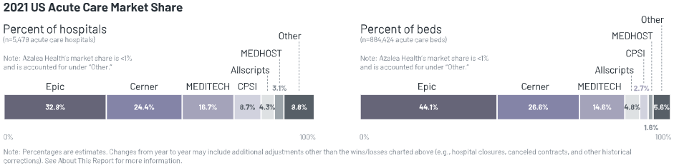
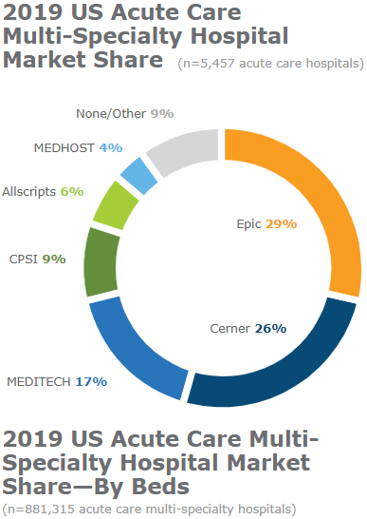
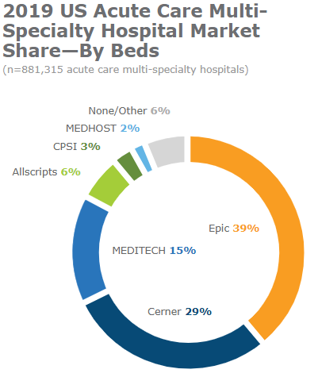

Slide 3
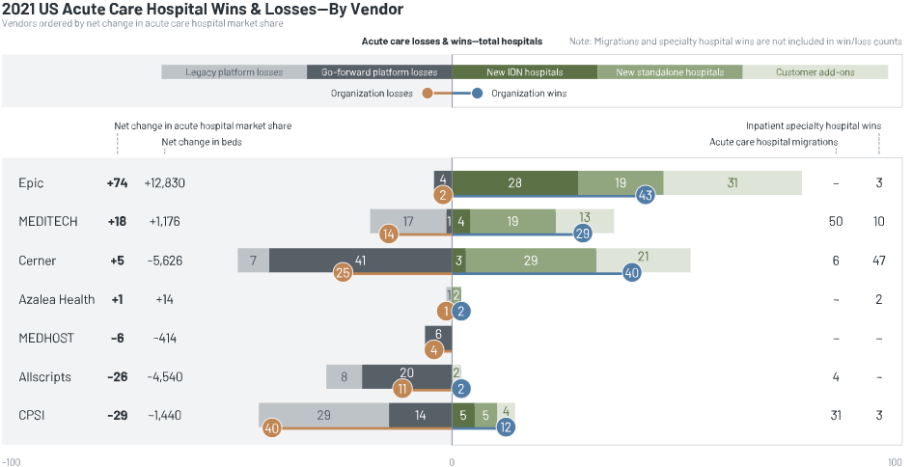

Slide 4
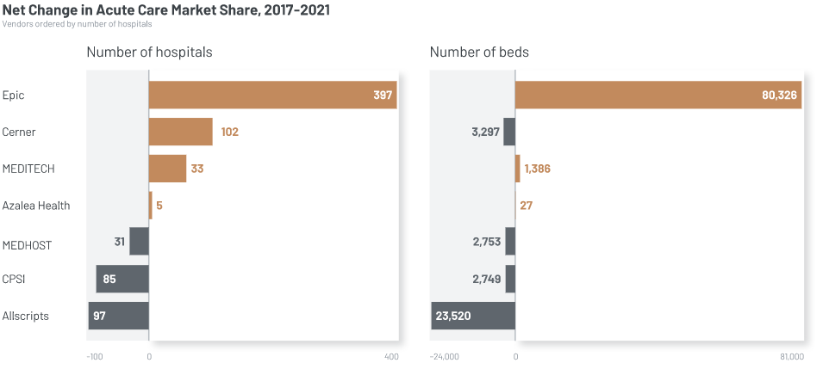

Slide 5
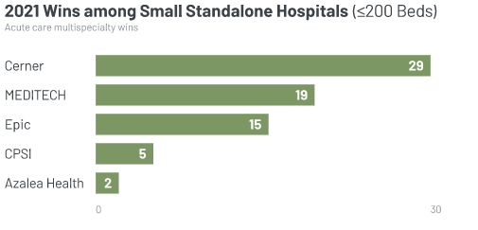

Slide 6
Key Players
Overall, EMR vendors struggle to compete with Epic in large organizations
Epic
Cerner
Meditech
Dominates large space
Tremendous integration across platform
Customers often love them
Broad technology stack
Lacks consistent rev cycle experience
Uncertainty due to acquisition, increasing employee turnover
Expanse improves clinician experience
Lacks broader technology (analytics, integrated post-acute)
Altera
CPSI
Uncertainty over acquisition, leadership not sharing a strategy
Large customers planning to leave
Small customers want to leave
Updated Physician Gui
Increasing focus on revenue cycle
Value option for small hospitals
Notes:
6

Slide 7
Overall Scores
Acute Care EMR
Market Average 79.2
Epic EpicCare Inpatient EMR (n=125)
89.8
MEDITECH Expanse Acute Care EMR (n=41)
84.2
Cerner Cerner Millennium PowerChart CommunityWorks Clinicals (n=112)
70.2
CPSI Evident Thrive EHR (n=28)
68.1
Altera Digital Health Sunrise (Allscripts) (n=19)
62.4
0
100

Slide 8
Satisfaction Comparison
Epic
5
73
99
MEDITECH
7
20
21
Highly Satisfied
Cerner
55
73
16
Satisfied
Unsatisfied
Altera Digital Health
17
7
2
CPSI
13
16
1
0%
100%

Slide 9
Question Score Breakout
Delivery of New Technology
Market Average 7.1
Epic EpicCare Inpatient EMR (n=120)
7.8
MEDITECH Expanse Acute Care EMR (n=40)
7.6
Cerner Cerner Millennium PowerChart CommunityWorks Clinicals (n=107)
6.6
CPSI Evident Thrive EHR (n=27)
6.6
Altera Digital Health Sunrise (Allscripts) (n=18)
5.3
1
9

Slide 10
Question Score Breakout
Ease of Use
Market Average 6.9
Epic EpicCare Inpatient EMR (n=123)
7.4
MEDITECH Expanse Acute Care EMR (n=41)
7.2
Cerner Cerner Millennium PowerChart CommunityWorks Clinicals (n=111)
6.6
CPSI Evident Thrive EHR (n=28)
6.4
Altera Digital Health Sunrise (Allscripts) (n=19)
6.0
1
9

Slide 11
Question Score Breakout
Executive Involvement
Market Average 7.4
Epic EpicCare Inpatient EMR (n=108)
7.9
MEDITECH Expanse Acute Care EMR (n=35)
7.9
Altera Digital Health Sunrise (Allscripts) (n=18)
6.9
Cerner Cerner Millennium PowerChart CommunityWorks Clinicals (n=101)
6.9
CPSI Evident Thrive EHR (n=25)
6.7
1
9

Slide 12
Question Score Breakout
Forecasted Overall Satisfaction
Market Average 7.4
Epic EpicCare Inpatient EMR (n=123)
8.1
MEDITECH Expanse Acute Care EMR (n=40)
7.7
Cerner Cerner Millennium PowerChart CommunityWorks Clinicals (n=106)
6.6
CPSI Evident Thrive EHR (n=25)
6.5
Altera Digital Health Sunrise (Allscripts) (n=16)
6.2
1
9

Slide 13
Question Score Breakout
Likely to Recommend
Market Average 7.2
Epic EpicCare Inpatient EMR (n=123)
8.5
MEDITECH Expanse Acute Care EMR (n=41)
7.5
Cerner Cerner Millennium PowerChart CommunityWorks Clinicals (n=112)
6.2
CPSI Evident Thrive EHR (n=28)
5.9
Altera Digital Health Sunrise (Allscripts) (n=19)
4.5
1
9

Slide 14
Question Score Breakout
Money's Worth
Market Average 7.0
Epic EpicCare Inpatient EMR (n=105)
7.8
MEDITECH Expanse Acute Care EMR (n=35)
7.8
CPSI Evident Thrive EHR (n=24)
6.6
Altera Digital Health Sunrise (Allscripts) (n=17)
6.2
Cerner Cerner Millennium PowerChart CommunityWorks Clinicals (n=102)
6.1
1
9

Slide 15
Question Score Breakout
Overall Product Quality
Market Average 7.4
Epic EpicCare Inpatient EMR (n=124)
8.2
MEDITECH Expanse Acute Care EMR (n=41)
7.6
Cerner Cerner Millennium PowerChart CommunityWorks Clinicals (n=112)
6.9
CPSI Evident Thrive EHR (n=28)
6.5
Altera Digital Health Sunrise (Allscripts) (n=19)
5.8
1
9

Slide 16
Question Score Breakout
Overall Satisfaction
Market Average 7.2
Epic EpicCare Inpatient EMR (n=124)
8.1
MEDITECH Expanse Acute Care EMR (n=41)
7.5
CPSI Evident Thrive EHR (n=27)
6.5
Cerner Cerner Millennium PowerChart CommunityWorks Clinicals (n=112)
6.4
Altera Digital Health Sunrise (Allscripts) (n=19)
5.7
1
9

Slide 17
Question Score Breakout
Proactive Service
Market Average 6.8
Epic EpicCare Inpatient EMR (n=113)
7.9
CPSI Evident Thrive EHR (n=26)
6.6
MEDITECH Expanse Acute Care EMR (n=39)
6.5
Cerner Cerner Millennium PowerChart CommunityWorks Clinicals (n=109)
6.0
Altera Digital Health Sunrise (Allscripts) (n=19)
5.7
1
9

Slide 18
Question Score Breakout
Product Works as Promoted
Market Average 7.4
Epic EpicCare Inpatient EMR (n=122)
8.1
MEDITECH Expanse Acute Care EMR (n=41)
7.8
Cerner Cerner Millennium PowerChart CommunityWorks Clinicals (n=112)
6.8
CPSI Evident Thrive EHR (n=27)
6.6
Altera Digital Health Sunrise (Allscripts) (n=19)
6.4
1
9

Slide 19
Question Score Breakout
Quality of Implementation
Market Average 7.1
Epic EpicCare Inpatient EMR (n=120)
7.9
MEDITECH Expanse Acute Care EMR (n=41)
7.3
Cerner Cerner Millennium PowerChart CommunityWorks Clinicals (n=107)
6.6
CPSI Evident Thrive EHR (n=27)
6.1
Altera Digital Health Sunrise (Allscripts) (n=17)
5.8
1
9

Slide 20
Question Score Breakout
Quality of Phone/Web Support
Market Average 7.1
Epic EpicCare Inpatient EMR (n=109)
8.1
MEDITECH Expanse Acute Care EMR (n=39)
7.5
CPSI Evident Thrive EHR (n=27)
6.7
Altera Digital Health Sunrise (Allscripts) (n=18)
6.3
Cerner Cerner Millennium PowerChart CommunityWorks Clinicals (n=101)
6.1
1
9

Slide 21
Question Score Breakout
Quality of Training
Market Average 6.8
Epic EpicCare Inpatient EMR (n=115)
7.7
MEDITECH Expanse Acute Care EMR (n=39)
6.8
CPSI Evident Thrive EHR (n=28)
6.4
Cerner Cerner Millennium PowerChart CommunityWorks Clinicals (n=99)
5.8
*Limited data
*Limited Data
*Limited Data
*Limited Data
*Limited Data
*Limited Data
*Limited Data
Altera Digital Health Sunrise (Allscripts) (n=13)
5.5*
1
9

Slide 22
Question Score Breakout
Supports Integration Goals
Market Average 7.4
Epic EpicCare Inpatient EMR (n=121)
8.1
MEDITECH Expanse Acute Care EMR (n=40)
7.7
Cerner Cerner Millennium PowerChart CommunityWorks Clinicals (n=112)
6.8
CPSI Evident Thrive EHR (n=28)
6.4
Altera Digital Health Sunrise (Allscripts) (n=18)
6.2
1
9

Slide 23
Question Score Breakout
Product has Needed Functionality
Market Average 7.1
Epic EpicCare Inpatient EMR (n=125)
7.7
MEDITECH Expanse Acute Care EMR (n=41)
7.4
Cerner Cerner Millennium PowerChart CommunityWorks Clinicals (n=110)
6.6
CPSI Evident Thrive EHR (n=28)
6.3
Altera Digital Health Sunrise (Allscripts) (n=19)
6.0
1
9

Slide 24
Question Score Breakout
Drives Tangible Outcomes
Market Average 7.3
Epic EpicCare Inpatient EMR (n=118)
7.9
MEDITECH Expanse Acute Care EMR (n=41)
7.6
Cerner Cerner Millennium PowerChart CommunityWorks Clinicals (n=108)
6.7
CPSI Evident Thrive EHR (n=26)
6.3
Altera Digital Health Sunrise (Allscripts) (n=19)
6.0
1
9

Slide 25
Question Score Breakout
Avoids Nickel and Diming
Market Average 60%
MEDITECH Expanse Acute Care EMR (n=28)
88%
Epic EpicCare Inpatient EMR (n=92)
85%
Altera Digital Health Sunrise (Allscripts) (n=17)
61%
CPSI Evident Thrive EHR (n=23)
42%
Cerner Cerner Millennium PowerChart CommunityWorks Clinicals (n=97)
30%
0%
100%

Slide 26
Question Score Breakout
Part of Long Term Plans
Market Average 91%
Epic EpicCare Inpatient EMR (n=125)
100%
MEDITECH Expanse Acute Care EMR (n=41)
96%
Cerner Cerner Millennium PowerChart CommunityWorks Clinicals (n=107)
90%
Altera Digital Health Sunrise (Allscripts) (n=19)
65%
CPSI Evident Thrive EHR (n=26)
62%
0%
100%

Slide 27
Question Score Breakout
Would you Buy Again
Market Average 83%
Epic EpicCare Inpatient EMR (n=123)
99%
MEDITECH Expanse Acute Care EMR (n=41)
85%
Cerner Cerner Millennium PowerChart CommunityWorks Clinicals (n=107)
74%
CPSI Evident Thrive EHR (n=26)
57%
Altera Digital Health Sunrise (Allscripts) (n=19)
38%
0%
100%

Slide 28
Question Score Breakout
Keeps All promises
Market Average 74%
Epic EpicCare Inpatient EMR (n=119)
95%
MEDITECH Expanse Acute Care EMR (n=39)
89%
CPSI Evident Thrive EHR (n=23)
56%
Cerner Cerner Millennium PowerChart CommunityWorks Clinicals (n=109)
53%
Altera Digital Health Sunrise (Allscripts) (n=19)
36%
0%
100%

Slide 29
Moving from Fee-for-Service to Fee-for-Value
How KLAS sees Population Health
Fee-for-service
Pay for performance
Upside
Risk
Downside
Risk
Bundled Payments
Full Capitation
Payviders
Payment model is shifting driven by
government initiatives and regulations
  Spending is high
  Outcomes are low
  Something must change
    Meaningful Use, MACRA, MIPS

Slide 30
Definitions
Value-Based Care
Transition from fee-for-service to fee-for-value. Centers around payment reform.
Population Health
Management
The analytical tools used to support value-based contracts
Care Management
Tools and processes to manage the care of individual patients within a population. Typically used by care managers that work with providers to care for patient populations. Helps someone navigate their journey of health.
ACOs
Accountable Care Organization: A group of healthcare organizations banded together to manage the care of population from end-to-end. ACOs are the purchasing group for many PHM solutions.

Slide 31
Population Health Framework
What you should be learning today
1
Data aggregation
4
Financials
2
Data analysis
5
Patient Engagement
3
Care Management
6
Clinician Engagement

Slide 32
Where does Population Health Management fit?
Population Health Management
VBC Consulting
VBC Managed Services
Software
Pre-packaged IT solutions that provide analytics and care management functions to understand, analyze, and proactively manage patient populations
Service
Engagements focused on helping organizations shift from fee for service to fee for value, which should result in improved quality and patient care, reduced population risk and better patient outcomes and experiences
Service & Software
Ongoing operational engagements that help hospitals, health systems, payers and physicians more effectively manage patient populations.

Slide 33
History of Population Health-Where We’ve Been
Buzz word
Replacement market
Data is everything
Anything and everything is “Population Health”
After being a supplemental market for years, replacements start happening
Commercial payers, from payer, clinicals, and broader population data
KLAS Summit
CM functionality is essential
Bring providers and vendors together to define the Population Health Framework
Vendors work to roll out longitudinal patient records for care managers to close care gaps.

Slide 34
Value Based Care Adoption

Slide 35
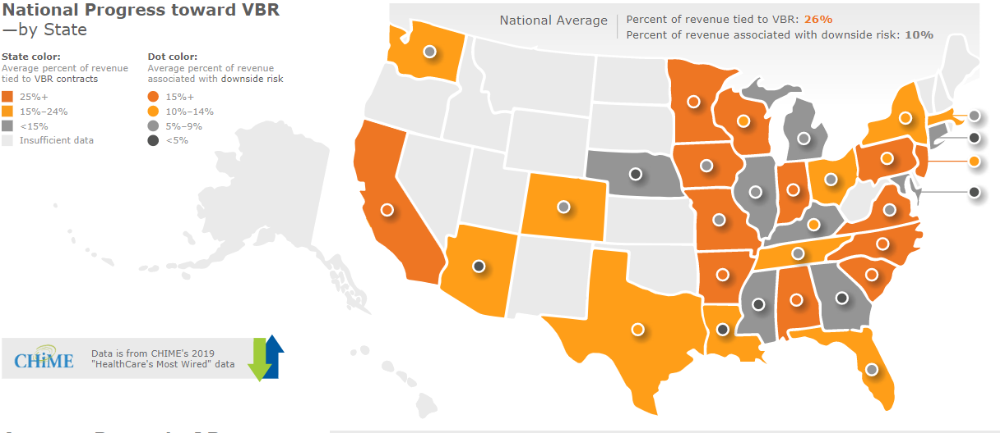
Value Based Care Adoption in 2019 and 2022
2022 Average is 36% n=42

Slide 36
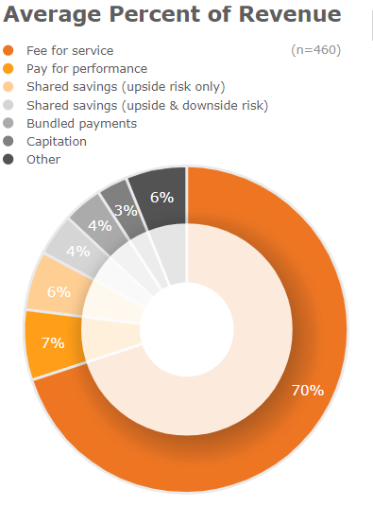
Breakdown of Risk in 2019 and 2022

Slide 37
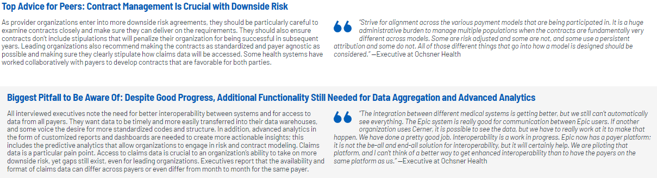
What Do More Advanced Orgs Think the Biggest Hurdle is?

Slide 38
Population Health-What’s Happening Today
ACO Reshuffle
Fully Managed Decline
Payers Push Downside Risk
Not all ACO’s are successful, and not all ACO’s members are aligned by objective
Providers have expanded internal knowledge and operations and prefer to partner for short term services engagements to learn from.
Commercial payers and CMS aren’t backing down from Risk. Starting to lead with more and more downside risk options.
SDOH Summit
Hybrid Models Don’t Work
March of 2023 KLAS will bring together vendors and providers to build a framework around financially sustainable SDOH programs
Health systems struggle to create processes and clinical workflows that support both service models. Leading orgs set up shadow organizations to fully embrace risk.

Slide 39
Key Trends Vendors Grapple With
Population Health Management
Outcomes are King
Expectation Management
Outcomes for PHM customers mean lower costs and better patient care. When not realized, functionality pains magnified
As this segment continues to mature,
customer have greater expectations that
aren’t being managed
Functionality Gaps
Service Needs
Still a belief that no one vendor can do it all. Functionality is missing and development is not strong enough
Customers rely on their PHM vendors for
strategic guidance and industry expertise

Slide 40
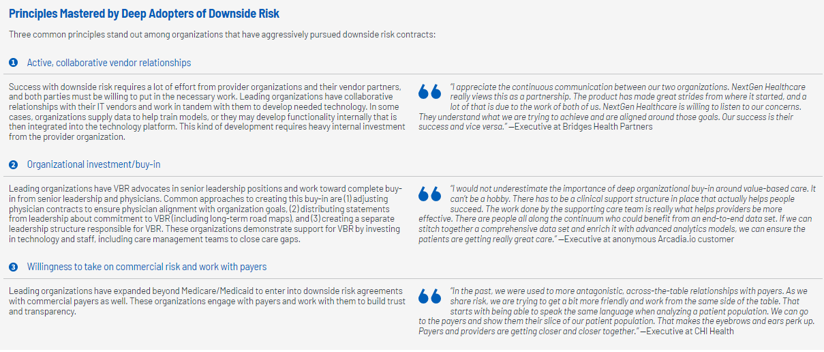
Population Health-What are Deep Adopters of Downside Risk Focused On

Slide 41





Deep Risk Adopters | Leaders in downside risk leverage PHOs to revolutionize operations
Forward looking Financial modeling for risk contracts that integrates cost data and population data.
Align incentives across the full continuum of care. Done through acquisition, ACO’s, or other risk sharing contracts.
Empower care coordinators with tools to identify at risk patients. Longitudinal tracking tools and analytics to create physician action list at point of care for visit.
Physician engages patient with pre-made action list during visit, creates care plan that includes entire care team. Care team has TOC document.
A mix of technology and care team are leveraged to engage patient moving forward. CBO’s can be included with service requests.

Slide 42




Barriers to Operational Transformation | What providers say is still not working
Executive Involvement
With increased use of portals, telehealth, and patient communication solutions, physician inboxes are bombarded like never before with small action items. Enterprise communications, more efficient mobile documentation solutions, virtual provider to provider communication solutions help.
Small organizations struggle with resources to invest in IT and personnel to effectively run value based operations. Many outpatient ACOs and Physician led organizations can’t mount the resources needed.
Value based operations require significant change management to nearly all clinician and operational workflows to align standard workflows across enterprise so data flows easily with patients along care continuum.
Assessments and CBO networks are nice, but ultimately organizations must have automated tools for service requests and service fulfillment by CBOs for care team to stay engaged after discharge.
Clinician Inbox
Large Wins
Enterprise Alignment
SDOH

Slide 43
Key Players

Slide 44
Key Players
Relevant (West)
Cedar Gate
HealthEC (BIK)
Innovaccer
Primarily focus on FQHCs
Large customer base in western US
Easy to use and Robust reporting tools
More robust financials needed
Big focus on helping orgs use claims data
Strength with care management
Highly engaged with customers and to enable use of data and understanding contracts
Offers many customized dashboards
Consistent delivery of new technology
Each install is highly customized
Driving outcomes
Health Catalyst
Arcadia
Lightbeam
Salient
Strong partner focused on outcomes
Consulting services are expensive
Care management has improved
Strong patient outcome tracking
Good integration to enable data acquisition
Strong relationships drive loyalty
Concerns around consistency as vendor scales
Strong data acquisition
Very customizable and varied experience
Expensive interfacing
Optum
Azara
United Healthcare owns them, which creates conflict of interest
New OPA is easier to use
Data mapping a frustration
Primarily FQHC and Ambulatory
QM reporting a strength
Administration values dashboards
Notes:
44

Slide 45
Key Players
Overall, EMR vendors struggle to deliver strong Care Management workflows
Epic
Cerner
NextGen
Guidance improving, along with functionality
Strong integration and workflows
External data a hurdle
Collaboration with customers
Lacks deep industry expertise
Fewer financial outcomes reported, as customers struggle with reporting
Acquired Eagle Dream Health
Data is available and easy to pull, but doesn’t serve up actionable insights
Care management a gap
Altera
Weak integration and out-of-box functionality
Not keeping pace with customer expectations
Notes:
45

Slide 46
Overall Scores
Population Health Management
Market Average 83.3
HealthEC HealthEC Population Health Management Suite (n=17)
93.9
Relevant Healthcare Relevant Healthcare Analytics (Regional - West) [C] (n=9)
92.8
Salient Healthcare Salient Healthcare (n=14)
89.9
Innovaccer Innovaccer Population Health (n=19)
88.1
Health Catalyst Health Catalyst Population Health Applications (n=18)
87.6
Innovaccer Population Health Management (n=18)
87.4
Altera Digital Health CareInMotion (Allscripts) (n=10)
85.1
Epic Healthy Planet (n=39)
84.4
NextGen Healthcare NextGen Healthcare Population Health Analytics (n=12)
84.4
Lightbeam Lightbeam Population Health Management (n=20)
77.9
Arcadia.io Arcadia Analytics (n=24)
77.4
Optum Optum Performance Analytics (n=5)
75.9
Cerner HealtheIntent Suite (n=36)
75.3
0
100

Slide 47
Satisfaction Comparison
Relevant Healthcare
2
8
HealthEC
5
14
Innovaccer
6
10
40
Salient Healthcare
6
10
Health Catalyst
1
11
12
Lightbeam
7
6
10
Highly Satisfied
Optum
Satisfied
1
2
2
Unsatisfied
Altera Digital Health
2
4
4
Epic
6
21
16
Arcadia.io
11
11
13
NextGen Healthcare
10
3
Cerner
14
28
8
0%
100%

Slide 48
Question Score Breakout
Delivery of New Technology
Market Average 7.2
Relevant Healthcare Relevant Healthcare Analytics (Regional - West) [C] (n=9)
8.4
HealthEC HealthEC Population Health Management Suite (n=16)
8.3
Innovaccer Innovaccer Population Health (n=19)
7.9
Innovaccer Population Health Management (n=18)
7.8
Lightbeam Lightbeam Population Health Management (n=18)
7.5
Salient Healthcare Salient Healthcare (n=11)
7.3
Health Catalyst Health Catalyst Population Health Applications (n=18)
7.2
NextGen Healthcare NextGen Healthcare Population Health Analytics (n=12)
7.2
Epic Healthy Planet (n=39)
7.1
Altera Digital Health CareInMotion (Allscripts) (n=10)
6.9
Arcadia.io Arcadia Analytics (n=23)
6.7
Optum Optum Performance Analytics (n=5)
6.6
Cerner HealtheIntent Suite (n=34)
6.3
1
9

Slide 49
Question Score Breakout
Ease of Use
Market Average 7.4
HealthEC HealthEC Population Health Management Suite (n=17)
8.3
Relevant Healthcare Relevant Healthcare Analytics (Regional - West) [C] (n=9)
8.3
Altera Digital Health CareInMotion (Allscripts) (n=10)
8.1
Innovaccer Innovaccer Population Health (n=19)
8.1
Innovaccer Population Health Management (n=18)
8.1
Health Catalyst Health Catalyst Population Health Applications (n=17)
7.7
NextGen Healthcare NextGen Healthcare Population Health Analytics (n=12)
7.6
Lightbeam Lightbeam Population Health Management (n=20)
7.3
Arcadia.io Arcadia Analytics (n=24)
7.2
Salient Healthcare Salient Healthcare (n=13)
7.1
Epic Healthy Planet (n=37)
7.0
Cerner HealtheIntent Suite (n=35)
6.7
*Limited data
*Limited Data
*Limited Data
*Limited Data
*Limited Data
*Limited Data
*Limited Data
*Limited Data
*Limited Data
*Limited Data
*Limited Data
*Limited Data
*Limited Data
*Limited Data
*Limited Data
Optum Optum Performance Analytics (n=4)
7.0*
1
9

Slide 50
Question Score Breakout
Executive Involvement
Market Average 7.9
HealthEC HealthEC Population Health Management Suite (n=17)
8.6
Relevant Healthcare Relevant Healthcare Analytics (Regional - West) [C] (n=9)
8.4
Altera Digital Health CareInMotion (Allscripts) (n=8)
8.3
Health Catalyst Health Catalyst Population Health Applications (n=18)
8.3
Innovaccer Innovaccer Population Health (n=19)
8.3
Salient Healthcare Salient Healthcare (n=12)
8.3
Innovaccer Population Health Management (n=18)
8.2
Arcadia.io Arcadia Analytics (n=24)
8.0
NextGen Healthcare NextGen Healthcare Population Health Analytics (n=10)
7.9
Lightbeam Lightbeam Population Health Management (n=18)
7.7
Epic Healthy Planet (n=32)
7.6
Cerner HealtheIntent Suite (n=30)
7.3
Optum Optum Performance Analytics (n=5)
6.2
1
9

Slide 51
Question Score Breakout
Forecasted Overall Satisfaction
Market Average 7.7
Relevant Healthcare Relevant Healthcare Analytics (Regional - West) [C] (n=9)
8.6
HealthEC HealthEC Population Health Management Suite (n=17)
8.5
Salient Healthcare Salient Healthcare (n=13)
8.3
Health Catalyst Health Catalyst Population Health Applications (n=14)
8.1
Innovaccer Innovaccer Population Health (n=19)
8.1
NextGen Healthcare NextGen Healthcare Population Health Analytics (n=11)
8.1
Innovaccer Population Health Management (n=18)
8.0
Altera Digital Health CareInMotion (Allscripts) (n=7)
7.9
Epic Healthy Planet (n=38)
7.6
Lightbeam Lightbeam Population Health Management (n=18)
7.6
Arcadia.io Arcadia Analytics (n=24)
7.3
Cerner HealtheIntent Suite (n=31)
7.0
Optum Optum Performance Analytics (n=5)
6.6
1
9

Slide 52
Question Score Breakout
Likely to Recommend
Market Average 7.5
HealthEC HealthEC Population Health Management Suite (n=17)
8.6
Relevant Healthcare Relevant Healthcare Analytics (Regional - West) [C] (n=8)
8.6
Altera Digital Health CareInMotion (Allscripts) (n=9)
8.2
Health Catalyst Health Catalyst Population Health Applications (n=18)
8.1
Innovaccer Innovaccer Population Health (n=19)
8.0
Salient Healthcare Salient Healthcare (n=14)
8.0
Epic Healthy Planet (n=39)
7.9
Innovaccer Population Health Management (n=18)
7.9
NextGen Healthcare NextGen Healthcare Population Health Analytics (n=12)
7.5
Lightbeam Lightbeam Population Health Management (n=20)
6.8
Optum Optum Performance Analytics (n=5)
6.8
Cerner HealtheIntent Suite (n=34)
6.7
Arcadia.io Arcadia Analytics (n=24)
6.6
1
9

Slide 53
Question Score Breakout
Money's Worth
Market Average 7.3
HealthEC HealthEC Population Health Management Suite (n=16)
8.4
Altera Digital Health CareInMotion (Allscripts) (n=8)
8.1
Relevant Healthcare Relevant Healthcare Analytics (Regional - West) [C] (n=8)
8.1
Innovaccer Innovaccer Population Health (n=18)
7.9
Innovaccer Population Health Management (n=17)
7.9
Salient Healthcare Salient Healthcare (n=14)
7.9
NextGen Healthcare NextGen Healthcare Population Health Analytics (n=12)
7.6
Health Catalyst Health Catalyst Population Health Applications (n=17)
7.5
Epic Healthy Planet (n=32)
7.2
Lightbeam Lightbeam Population Health Management (n=18)
7.1
Arcadia.io Arcadia Analytics (n=23)
6.7
Cerner HealtheIntent Suite (n=33)
6.5
Optum Optum Performance Analytics (n=5)
6.4
1
9

Slide 54
Question Score Breakout
Overall Product Quality
Market Average 7.6
Relevant Healthcare Relevant Healthcare Analytics (Regional - West) [C] (n=9)
8.5
HealthEC HealthEC Population Health Management Suite (n=17)
8.3
Salient Healthcare Salient Healthcare (n=14)
8.3
Innovaccer Innovaccer Population Health (n=19)
7.9
NextGen Healthcare NextGen Healthcare Population Health Analytics (n=12)
7.9
Epic Healthy Planet (n=37)
7.8
Innovaccer Population Health Management (n=18)
7.8
Altera Digital Health CareInMotion (Allscripts) (n=10)
7.7
Health Catalyst Health Catalyst Population Health Applications (n=18)
7.6
Optum Optum Performance Analytics (n=5)
7.4
Lightbeam Lightbeam Population Health Management (n=20)
7.1
Arcadia.io Arcadia Analytics (n=24)
7.0
Cerner HealtheIntent Suite (n=36)
6.9
1
9

Slide 55
Question Score Breakout
Overall Satisfaction
Market Average 7.3
HealthEC HealthEC Population Health Management Suite (n=17)
8.4
Salient Healthcare Salient Healthcare (n=14)
8.2
Relevant Healthcare Relevant Healthcare Analytics (Regional - West) [C] (n=9)
8.1
Health Catalyst Health Catalyst Population Health Applications (n=18)
7.8
Altera Digital Health CareInMotion (Allscripts) (n=9)
7.7
Innovaccer Innovaccer Population Health (n=19)
7.7
Innovaccer Population Health Management (n=18)
7.6
NextGen Healthcare NextGen Healthcare Population Health Analytics (n=12)
7.5
Epic Healthy Planet (n=38)
7.4
Lightbeam Lightbeam Population Health Management (n=20)
7.0
Optum Optum Performance Analytics (n=5)
6.8
Cerner HealtheIntent Suite (n=36)
6.6
Arcadia.io Arcadia Analytics (n=24)
6.5
1
9

Slide 56
Question Score Breakout
Proactive Service
Market Average 7.1
Relevant Healthcare Relevant Healthcare Analytics (Regional - West) [C] (n=9)
8.5
HealthEC HealthEC Population Health Management Suite (n=16)
8.4
Salient Healthcare Salient Healthcare (n=13)
8.3
Epic Healthy Planet (n=38)
7.5
Health Catalyst Health Catalyst Population Health Applications (n=18)
7.5
Innovaccer Innovaccer Population Health (n=19)
7.3
Altera Digital Health CareInMotion (Allscripts) (n=9)
7.2
Innovaccer Population Health Management (n=18)
7.2
NextGen Healthcare NextGen Healthcare Population Health Analytics (n=11)
6.8
Arcadia.io Arcadia Analytics (n=23)
6.4
Cerner HealtheIntent Suite (n=35)
6.3
Lightbeam Lightbeam Population Health Management (n=19)
6.2
*Limited data
*Limited Data
*Limited Data
*Limited Data
*Limited Data
*Limited Data
*Limited Data
*Limited Data
*Limited Data
*Limited Data
*Limited Data
*Limited Data
*Limited Data
*Limited Data
*Limited Data
Optum Optum Performance Analytics (n=4)
6.0*
1
9

Slide 57
Question Score Breakout
Product Works as Promoted
Market Average 7.5
Relevant Healthcare Relevant Healthcare Analytics (Regional - West) [C] (n=9)
8.5
HealthEC HealthEC Population Health Management Suite (n=17)
8.4
Salient Healthcare Salient Healthcare (n=13)
8.1
Altera Digital Health CareInMotion (Allscripts) (n=10)
7.8
Health Catalyst Health Catalyst Population Health Applications (n=18)
7.7
Innovaccer Innovaccer Population Health (n=18)
7.7
Innovaccer Population Health Management (n=17)
7.6
NextGen Healthcare NextGen Healthcare Population Health Analytics (n=12)
7.6
Optum Optum Performance Analytics (n=5)
7.6
Epic Healthy Planet (n=37)
7.5
Arcadia.io Arcadia Analytics (n=24)
7.2
Lightbeam Lightbeam Population Health Management (n=20)
7.2
Cerner HealtheIntent Suite (n=36)
7.0
1
9

Slide 58
Question Score Breakout
Quality of Implementation
Market Average 7.2
Salient Healthcare Salient Healthcare (n=14)
8.2
Altera Digital Health CareInMotion (Allscripts) (n=10)
7.9
HealthEC HealthEC Population Health Management Suite (n=17)
7.8
Health Catalyst Health Catalyst Population Health Applications (n=18)
7.7
Epic Healthy Planet (n=34)
7.6
Relevant Healthcare Relevant Healthcare Analytics (Regional - West) [C] (n=9)
7.6
NextGen Healthcare NextGen Healthcare Population Health Analytics (n=11)
7.5
Optum Optum Performance Analytics (n=5)
7.4
Innovaccer Innovaccer Population Health (n=19)
7.3
Innovaccer Population Health Management (n=18)
7.2
Cerner HealtheIntent Suite (n=32)
6.8
Lightbeam Lightbeam Population Health Management (n=20)
6.8
Arcadia.io Arcadia Analytics (n=24)
6.0
1
9

Slide 59
Question Score Breakout
Quality of Phone/Web Support
Market Average 7.6
Relevant Healthcare Relevant Healthcare Analytics (Regional - West) [C] (n=9)
8.7
HealthEC HealthEC Population Health Management Suite (n=14)
8.6
Salient Healthcare Salient Healthcare (n=14)
8.5
Epic Healthy Planet (n=32)
8.3
Health Catalyst Health Catalyst Population Health Applications (n=16)
8.3
Innovaccer Innovaccer Population Health (n=18)
7.8
Innovaccer Population Health Management (n=17)
7.7
NextGen Healthcare NextGen Healthcare Population Health Analytics (n=11)
7.6
Altera Digital Health CareInMotion (Allscripts) (n=8)
7.3
Lightbeam Lightbeam Population Health Management (n=19)
7.0
Arcadia.io Arcadia Analytics (n=21)
6.8
Cerner HealtheIntent Suite (n=34)
6.4
*Limited data
*Limited Data
*Limited Data
*Limited Data
*Limited Data
*Limited Data
*Limited Data
*Limited Data
*Limited Data
*Limited Data
*Limited Data
*Limited Data
*Limited Data
*Limited Data
*Limited Data
Optum Optum Performance Analytics (n=4)
7.5*
1
9

Slide 60
Question Score Breakout
Quality of Training
Market Average 7.2
HealthEC HealthEC Population Health Management Suite (n=16)
8.2
Salient Healthcare Salient Healthcare (n=13)
8.0
Relevant Healthcare Relevant Healthcare Analytics (Regional - West) [C] (n=9)
7.9
Optum Optum Performance Analytics (n=5)
7.8
Epic Healthy Planet (n=30)
7.7
Innovaccer Innovaccer Population Health (n=18)
7.4
Altera Digital Health CareInMotion (Allscripts) (n=9)
7.3
Health Catalyst Health Catalyst Population Health Applications (n=18)
7.3
Innovaccer Population Health Management (n=17)
7.3
Lightbeam Lightbeam Population Health Management (n=19)
7.3
NextGen Healthcare NextGen Healthcare Population Health Analytics (n=11)
7.3
Arcadia.io Arcadia Analytics (n=24)
6.7
Cerner HealtheIntent Suite (n=31)
5.9
1
9

Slide 61
Question Score Breakout
Supports Integration Goals
Market Average 7.5
HealthEC HealthEC Population Health Management Suite (n=16)
8.1
Innovaccer Innovaccer Population Health (n=19)
8.1
Relevant Healthcare Relevant Healthcare Analytics (Regional - West) [C] (n=8)
8.1
Health Catalyst Health Catalyst Population Health Applications (n=17)
8.0
Innovaccer Population Health Management (n=18)
8.0
NextGen Healthcare NextGen Healthcare Population Health Analytics (n=11)
8.0
Altera Digital Health CareInMotion (Allscripts) (n=10)
7.7
Arcadia.io Arcadia Analytics (n=24)
7.7
Lightbeam Lightbeam Population Health Management (n=17)
7.3
Salient Healthcare Salient Healthcare (n=11)
7.3
Epic Healthy Planet (n=36)
7.1
Cerner HealtheIntent Suite (n=35)
7.0
Optum Optum Performance Analytics (n=5)
7.0
1
9

Slide 62
Question Score Breakout
Product has Needed Functionality
Market Average 7.0
HealthEC HealthEC Population Health Management Suite (n=17)
8.1
Altera Digital Health CareInMotion (Allscripts) (n=10)
7.5
Innovaccer Innovaccer Population Health (n=19)
7.5
Innovaccer Population Health Management (n=18)
7.5
NextGen Healthcare NextGen Healthcare Population Health Analytics (n=12)
7.5
Salient Healthcare Salient Healthcare (n=13)
7.5
Health Catalyst Health Catalyst Population Health Applications (n=18)
7.3
Relevant Healthcare Relevant Healthcare Analytics (Regional - West) [C] (n=8)
7.2
Lightbeam Lightbeam Population Health Management (n=20)
7.1
Optum Optum Performance Analytics (n=5)
7.0
Epic Healthy Planet (n=39)
6.7
Arcadia.io Arcadia Analytics (n=24)
6.3
Cerner HealtheIntent Suite (n=34)
6.1
1
9

Slide 63
Question Score Breakout
Drives Tangible Outcomes
Market Average 7.7
HealthEC HealthEC Population Health Management Suite (n=16)
8.4
Relevant Healthcare Relevant Healthcare Analytics (Regional - West) [C] (n=8)
8.4
Innovaccer Innovaccer Population Health (n=18)
8.2
Innovaccer Population Health Management (n=17)
8.1
Altera Digital Health CareInMotion (Allscripts) (n=8)
8.0
Salient Healthcare Salient Healthcare (n=13)
8.0
Health Catalyst Health Catalyst Population Health Applications (n=18)
7.9
NextGen Healthcare NextGen Healthcare Population Health Analytics (n=12)
7.9
Arcadia.io Arcadia Analytics (n=24)
7.6
Epic Healthy Planet (n=36)
7.6
Lightbeam Lightbeam Population Health Management (n=20)
7.2
Optum Optum Performance Analytics (n=5)
7.0
Cerner HealtheIntent Suite (n=31)
6.8
1
9

Slide 64
Question Score Breakout
Avoids Nickel and Diming
Market Average 85%
Innovaccer Innovaccer Population Health (n=18)
97%
Innovaccer Population Health Management (n=17)
96%
Health Catalyst Health Catalyst Population Health Applications (n=17)
95%
HealthEC HealthEC Population Health Management Suite (n=16)
94%
Relevant Healthcare Relevant Healthcare Analytics (Regional - West) [C] (n=8)
89%
Altera Digital Health CareInMotion (Allscripts) (n=8)
88%
Arcadia.io Arcadia Analytics (n=23)
88%
Epic Healthy Planet (n=35)
82%
Salient Healthcare Salient Healthcare (n=14)
81%
Lightbeam Lightbeam Population Health Management (n=20)
78%
Cerner HealtheIntent Suite (n=31)
77%
NextGen Healthcare NextGen Healthcare Population Health Analytics (n=12)
69%
*Limited data
*Limited Data
*Limited Data
*Limited Data
*Limited Data
*Limited Data
*Limited Data
*Limited Data
*Limited Data
*Limited Data
*Limited Data
*Limited Data
*Limited Data
*Limited Data
*Limited Data
Optum Optum Performance Analytics (n=4)
50%*
0%
100%

Slide 65
Question Score Breakout
Part of Long Term Plans
Market Average 94%
Epic Healthy Planet (n=39)
100%
HealthEC HealthEC Population Health Management Suite (n=16)
100%
Innovaccer Population Health Management (n=18)
100%
Relevant Healthcare Relevant Healthcare Analytics (Regional - West) [C] (n=9)
100%
Salient Healthcare Salient Healthcare (n=12)
100%
Innovaccer Innovaccer Population Health (n=19)
98%
Health Catalyst Health Catalyst Population Health Applications (n=17)
96%
Cerner HealtheIntent Suite (n=36)
95%
NextGen Healthcare NextGen Healthcare Population Health Analytics (n=12)
92%
Arcadia.io Arcadia Analytics (n=24)
88%
Altera Digital Health CareInMotion (Allscripts) (n=10)
80%
Lightbeam Lightbeam Population Health Management (n=16)
72%
*Limited data
*Limited Data
*Limited Data
*Limited Data
*Limited Data
*Limited Data
*Limited Data
*Limited Data
*Limited Data
*Limited Data
*Limited Data
*Limited Data
*Limited Data
*Limited Data
*Limited Data
Optum Optum Performance Analytics (n=4)
75%*
0%
100%

Slide 66
Question Score Breakout
Would you Buy Again
Market Average 91%
Health Catalyst Health Catalyst Population Health Applications (n=18)
100%
HealthEC HealthEC Population Health Management Suite (n=17)
100%
NextGen Healthcare NextGen Healthcare Population Health Analytics (n=11)
100%
Relevant Healthcare Relevant Healthcare Analytics (Regional - West) [C] (n=9)
100%
Salient Healthcare Salient Healthcare (n=13)
100%
Epic Healthy Planet (n=39)
95%
Innovaccer Innovaccer Population Health (n=19)
93%
Innovaccer Population Health Management (n=18)
92%
Altera Digital Health CareInMotion (Allscripts) (n=9)
89%
Cerner HealtheIntent Suite (n=31)
87%
Arcadia.io Arcadia Analytics (n=23)
82%
Optum Optum Performance Analytics (n=5)
80%
Lightbeam Lightbeam Population Health Management (n=19)
77%
0%
100%

Slide 67
Question Score Breakout
Keeps All promises
Market Average 78%
HealthEC HealthEC Population Health Management Suite (n=17)
100%
Relevant Healthcare Relevant Healthcare Analytics (Regional - West) [C] (n=9)
100%
Salient Healthcare Salient Healthcare (n=14)
100%
Health Catalyst Health Catalyst Population Health Applications (n=18)
88%
Innovaccer Innovaccer Population Health (n=19)
87%
Innovaccer Population Health Management (n=18)
85%
Epic Healthy Planet (n=37)
83%
NextGen Healthcare NextGen Healthcare Population Health Analytics (n=12)
77%
Altera Digital Health CareInMotion (Allscripts) (n=8)
75%
Lightbeam Lightbeam Population Health Management (n=19)
64%
Cerner HealtheIntent Suite (n=33)
63%
Arcadia.io Arcadia Analytics (n=23)
56%
*Limited data
*Limited Data
*Limited Data
*Limited Data
*Limited Data
*Limited Data
*Limited Data
*Limited Data
*Limited Data
*Limited Data
*Limited Data
*Limited Data
*Limited Data
*Limited Data
*Limited Data
Optum Optum Performance Analytics (n=4)
75%*
0%
100%

